Slide 1
Prognostic Pessimism for Depression

Slide 2
01
TABLE OF CONTENTS
02
03
04
BACKGROUND
Beliefs about mental disorders
QUESTIONNAIRE
Prognostic Pessimism for Depression
RESULTS
What T2T participants believe about depression
CONCLUSION
Time for feedback

Slide 3
01
BACKGROUND
Beliefs about mental disorders

Slide 4
Beliefs About Mental Disorders
Biomedical explanations for mental disorders are increasingly common¹
Notes:
¹Lebowitz, M. S., & Appelbaum, P. S. (2019). Biomedical explanations of psychopathology and their implications for attitudes and beliefs about mental disorders. Annual review of clinical psychology, 15, 555-577.
²Lebowitz, M. S., Rosenthal, J. E., & Ahn, W. K. (2016). Effects of biological versus psychosocial explanations on stigmatization of children with ADHD. Journal of attention disorders, 20(3), 240-250.
³Ahn, W. K., Proctor, C. C., & Flanagan, E. H. (2009). Mental health clinicians’ beliefs about the biological, psychological, and environmental bases of mental disorders. Cognitive science, 33(2), 147-182.
⁴Lebowitz, M. S., Ahn, W. K., & Nolen-Hoeksema, S. (2013). Fixable or fate? Perceptions of the biology of depression. Journal of consulting and clinical psychology, 81(3), 518.

Slide 5
Beliefs About Mental Disorders
Biomedical explanations for mental disorders are increasingly common¹
Holding biomedical explanations for mental disorders can lead to prognostic pessimism – the belief that depression will last for a longer time in the future²
Notes:
¹Lebowitz, M. S., & Appelbaum, P. S. (2019). Biomedical explanations of psychopathology and their implications for attitudes and beliefs about mental disorders. Annual review of clinical psychology, 15, 555-577.
²Lebowitz, M. S., Ahn, W. K., & Nolen-Hoeksema, S. (2013). Fixable or fate? Perceptions of the biology of depression. Journal of consulting and clinical psychology, 81(3), 518.
³Lebowitz, M. S., Rosenthal, J. E., & Ahn, W. K. (2016). Effects of biological versus psychosocial explanations on stigmatization of children with ADHD. Journal of attention disorders, 20(3), 240-250.
⁴Ahn, W. K., Proctor, C. C., & Flanagan, E. H. (2009). Mental health clinicians’ beliefs about the biological, psychological, and environmental bases of mental disorders. Cognitive science, 33(2), 147-182.
⁵Schroder, H. S. (2020). Mindsets in the clinic: Applying mindset theory to clinical psychology. Clinical Psychology Review, 101957.

Slide 6
Beliefs About Mental Disorders
Biomedical explanations for mental disorders are increasingly common¹
Holding biomedical explanations for mental disorders can lead to prognostic pessimism – the belief that depression will last for a longer time in the future²
Causal beliefs also have implications for social stigma,³ treatment choice,⁴ and, potentially, mindsets⁵
Notes:
¹Lebowitz, M. S., & Appelbaum, P. S. (2019). Biomedical explanations of psychopathology and their implications for attitudes and beliefs about mental disorders. Annual review of clinical psychology, 15, 555-577.
²Lebowitz, M. S., Ahn, W. K., & Nolen-Hoeksema, S. (2013). Fixable or fate? Perceptions of the biology of depression. Journal of consulting and clinical psychology, 81(3), 518.
³Lebowitz, M. S., Rosenthal, J. E., & Ahn, W. K. (2016). Effects of biological versus psychosocial explanations on stigmatization of children with ADHD. Journal of attention disorders, 20(3), 240-250.
⁴Ahn, W. K., Proctor, C. C., & Flanagan, E. H. (2009). Mental health clinicians’ beliefs about the biological, psychological, and environmental bases of mental disorders. Cognitive science, 33(2), 147-182.
⁵Schroder, H. S. (2020). Mindsets in the clinic: Applying mindset theory to clinical psychology. Clinical Psychology Review, 101957.

Slide 7
(Competing?) Explanations for Depression
BIOLOGICAL
PSYCHOLOGICAL
e.g., Depression is the result of a chemical imbalance in the brain
e.g., Depression is the result of learned helplessness
ENVIRONMENTAL
e.g., Depression is the result of stress or trauma
MORE?

Slide 8
02
QUESTIONNAIRE
Prognostic Pessimism for Depression

Slide 9
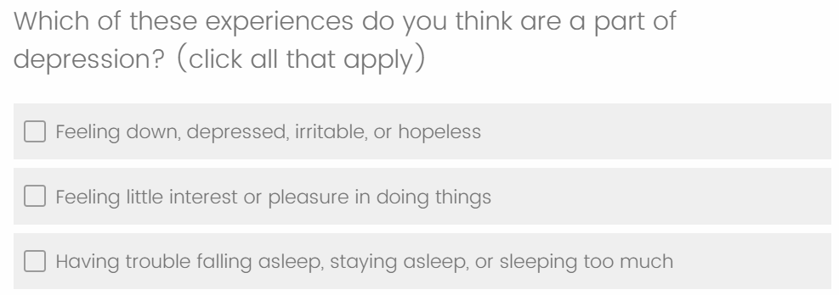
Question 1: Symptoms

Slide 10
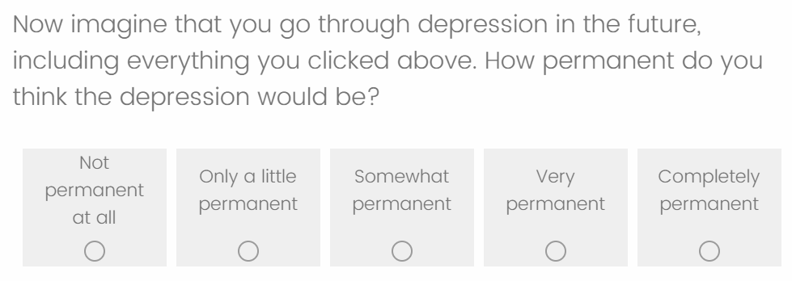
Question 2: Permanence

Slide 11
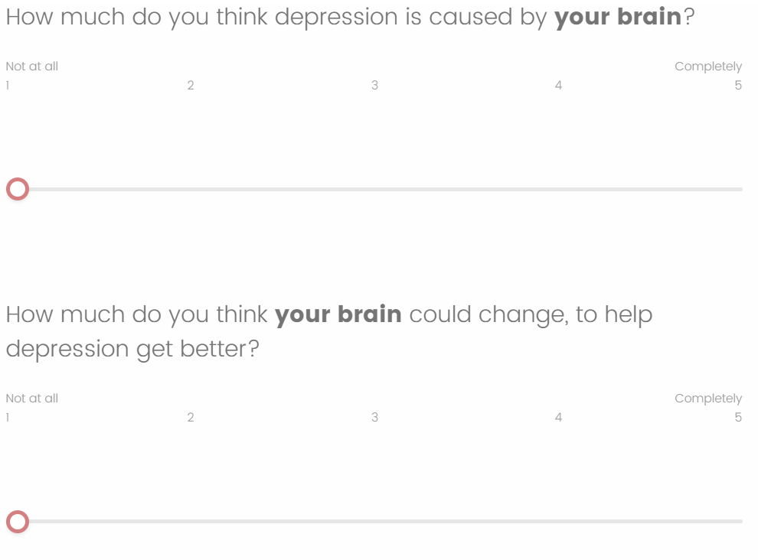
Question 3: Cause

Slide 12
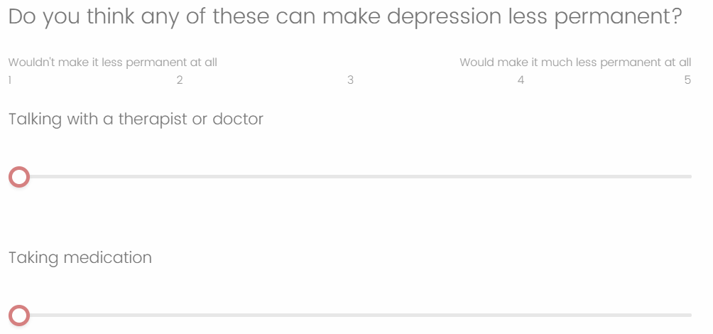
Question 4: Treatment

Slide 13
03
RESULTS
What T2T participants believe about depression

Slide 14
Research Question 1
What symptoms do high-symptom adolescents and their parents believe are a part of depression?

Slide 15
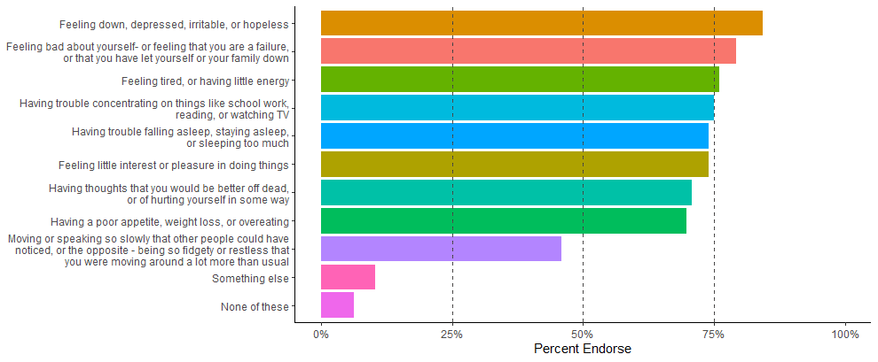
What Symptoms are a Part of Depression?

Slide 16
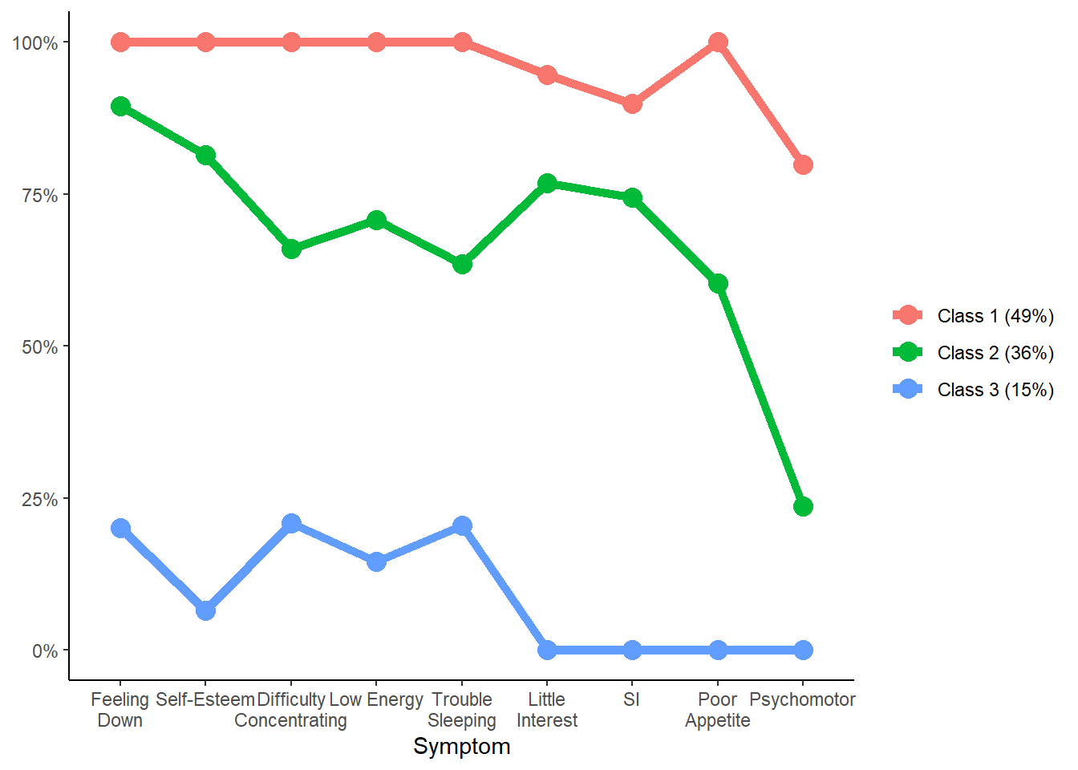
Latent Class Analysis
Disproportionately Female
Oldest
Lowest CDI Score
Youngest

Slide 17
Demographic Predictors
 |  | Gender |  |  | Age |  |  | Family Income
Symptom | Overall | Male | Female | F | 11-13 | 14-16 | F | Low | High | F
Feeling Down | 0.84 | 0.73 | 0.90 | 4.5** | 0.79 | 0.87 | 0.97 | 0.84 | 0.85 | 0.02
Little Interest | 0.74 | 0.64 | 0.81 | 3.42* | 0.62 | 0.81 | 4.16** | 0.74 | 0.74 | 0.01
Trouble Sleeping | 0.74 | 0.61 | 0.83 | 5.69** | 0.62 | 0.81 | 4.16** | 0.70 | 0.77 | 0.7
Poor Appetite | 0.70 | 0.52 | 0.81 | 9.51*** | 0.56 | 0.77 | 4.98** | 0.63 | 0.75 | 1.81
Low Energy | 0.76 | 0.61 | 0.83 | 5.69** | 0.59 | 0.85 | 9.21*** | 0.77 | 0.75 | 0.02
Self-Esteem | 0.79 | 0.73 | 0.83 | 1.27 | 0.74 | 0.82 | 1 | 0.79 | 0.79 | 0
Difficulty Concentrating | 0.75 | 0.61 | 0.84 | 6.89** | 0.65 | 0.81 | 3.01* | 0.74 | 0.75 | 0.01
Psychomotor | 0.46 | 0.36 | 0.50 | 1.57 | 0.47 | 0.45 | 0.03 | 0.35 | 0.55 | 3.83*
Suicidal Ideation | 0.71 | 0.70 | 0.72 | 0.07 | 0.62 | 0.76 | 2.1 | 0.67 | 0.74 | 0.43
Other | 0.10 | 0.06 | 0.12 | 0.84 | 0.09 | 0.11 | 0.14 | 0.05 | 0.15 | 2.8*
None | 0.06 | 0.12 | 0.03 | 2.59 | 0.09 | 0.05 | 0.59 | 0.07 | 0.06 | 0.07

Slide 18
Children vs Parents
Symptom | Overall | Child | Parent | F
Feeling Down | 0.92 | 0.84 | 0.99 | 14.21***
Little Interest | 0.86 | 0.74 | 0.98 | 25.6***
Trouble Sleeping | 0.85 | 0.74 | 0.96 | 19.55***
Poor Appetite | 0.83 | 0.70 | 0.96 | 25.69***
Low Energy | 0.86 | 0.76 | 0.97 | 19.41***
Self-Esteem | 0.88 | 0.79 | 0.97 | 15.26***
Difficulty Concentrating | 0.84 | 0.75 | 0.93 | 11.68***
Psychomotor | 0.59 | 0.46 | 0.72 | 14.3***
Suicidal Ideation | 0.82 | 0.71 | 0.94 | 18.81***
Other | 0.11 | 0.10 | 0.11 | 0.05
None | 0.04 | 0.06 | 0.01 | 3.74*

Slide 19
Research Question 2
What beliefs do high-symptom adolescents and their parents hold about the causes and permanency of depression?

Slide 20
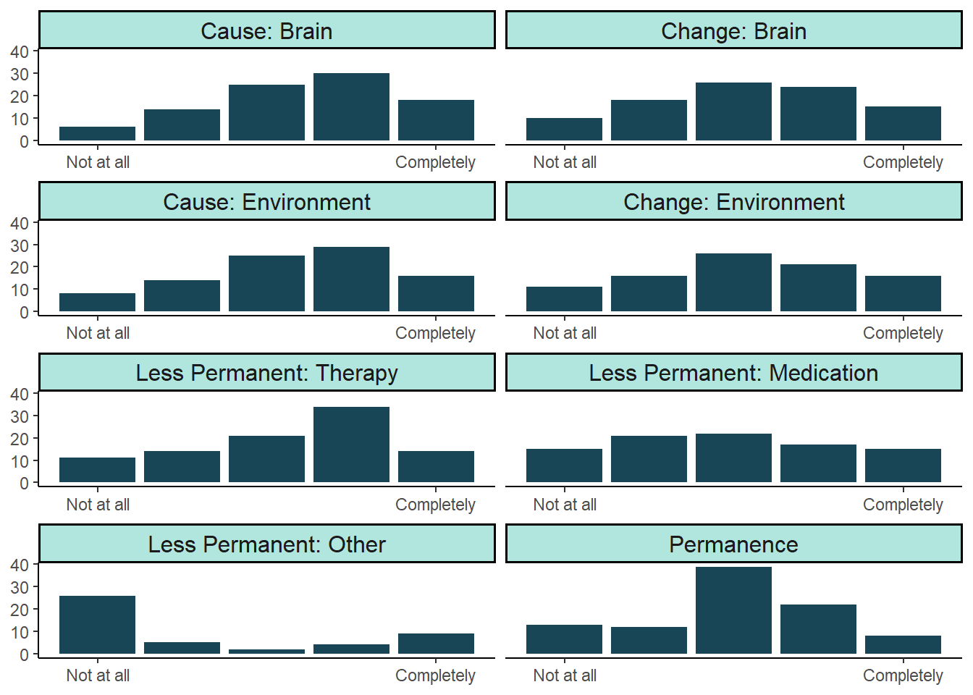
Overview

Slide 21
Demographic Predictors
 |  | Gender |  |  | Age |  |  | Family Income
Construct | Overall | Male | Female | F | 11-13 | 14-16 | F | Low | High | F
Permanence | 3.00 | 2.55 | 3.21 | 7.68*** | 2.62 | 3.19 | 5.65** | 3.12 | 2.90 | 0.85
Brain causes depression | 3.43 | 3.35 | 3.51 | 0.35 | 3.39 | 3.45 | 0.06 | 3.32 | 3.52 | 0.7
Brain can change | 3.17 | 3.39 | 3.02 | 1.87 | 3.52 | 3.00 | 3.75* | 3.12 | 3.21 | 0.12
Environment causes depression | 3.34 | 3.29 | 3.38 | 0.1 | 3.13 | 3.44 | 1.44 | 3.41 | 3.27 | 0.31
Environment can change | 3.17 | 3.17 | 3.18 | 0 | 3.38 | 3.07 | 1.21 | 2.98 | 3.33 | 1.73
Therapy makes depression less permanent | 3.28 | 3.00 | 3.43 | 2.51 | 3.44 | 3.19 | 0.83 | 3.00 | 3.50 | 3.96**
Medication makes depression less permanent | 2.96 | 2.57 | 3.13 | 3.48* | 2.77 | 3.05 | 0.9 | 2.60 | 3.27 | 6.1**
Something else makes depression less permanent | 2.24 | 1.67 | 2.52 | 3.43* | 2.47 | 2.13 | 0.42 | 2.14 | 2.32 | 0.13

Slide 22
Children vs Parents
Construct | Overall | Child | Parent | F
Permanence | 2.77 | 3.00 | 2.55 | 8.3***
Brain causes depression | 3.58 | 3.43 | 3.73 | 4.35**
Brain can change | 3.51 | 3.17 | 3.83 | 19.45***
Environment causes depression | 3.45 | 3.34 | 3.55 | 1.94
Environment can change | 3.50 | 3.17 | 3.82 | 15.08***
Therapy makes depression less permanent | 3.67 | 3.28 | 4.08 | 29.77***
Medication makes depression less permanent | 3.16 | 2.96 | 3.35 | 5.05**
Something else makes depression less permanent | 2.76 | 2.24 | 3.34 | 11.45***

Slide 23
Research Question 3
How do beliefs about the causes and permanency of depression correlate with one another, and with other relevant constructs?

Slide 24
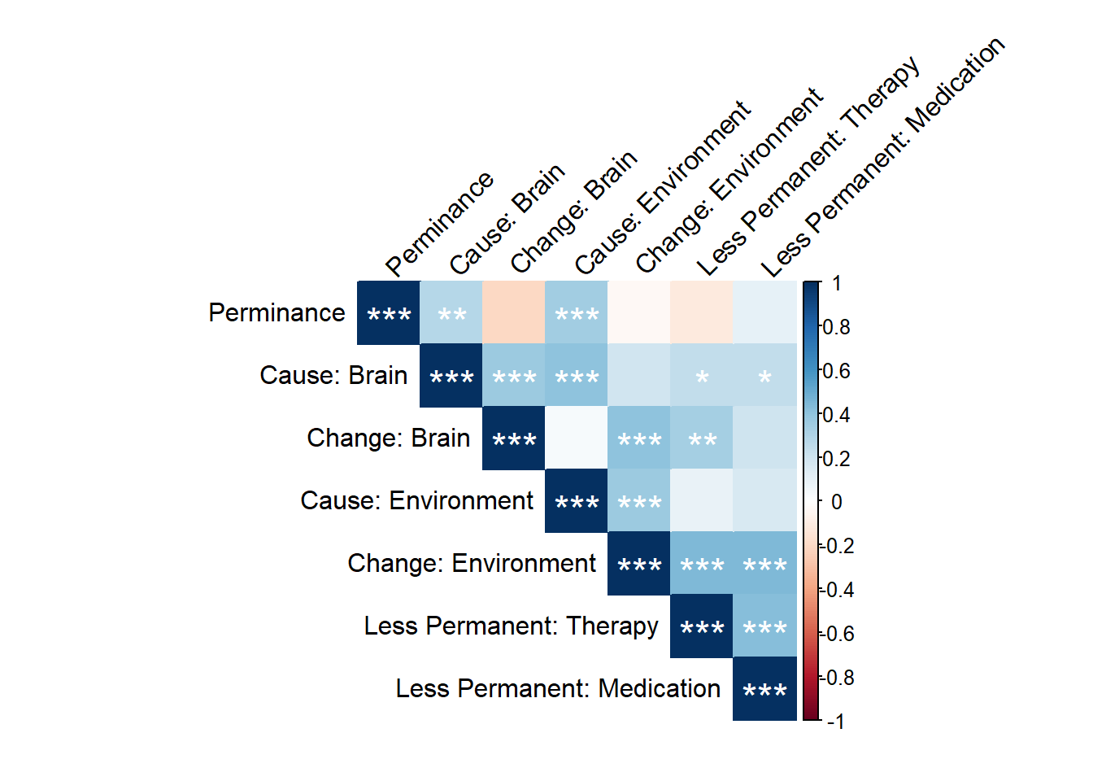
There are weak-to-moderate correlations between related constructs

Slide 25
There are weak-to-moderate correlations between related constructs
Youth who attribute more causality to the brain tend to also attribute more causality to the environment

Slide 26
There are weak-to-moderate correlations between related constructs
Youth who attribute more causality to the brain tend to also attribute more causality to the environment
Youth who think the brain/environment causes depression are more likely to think the brain/environment can change to help depression get better

Slide 27
There are weak-to-moderate correlations between related constructs
Youth who attribute more causality to the brain tend to also attribute more causality to the environment
Youth who think the brain/environment causes depression are more likely to think the brain/environment can change to help depression get better
Youth who think the brain/environment causes depression are not more likely to think the environment/brain can change to help depression get better

Slide 28
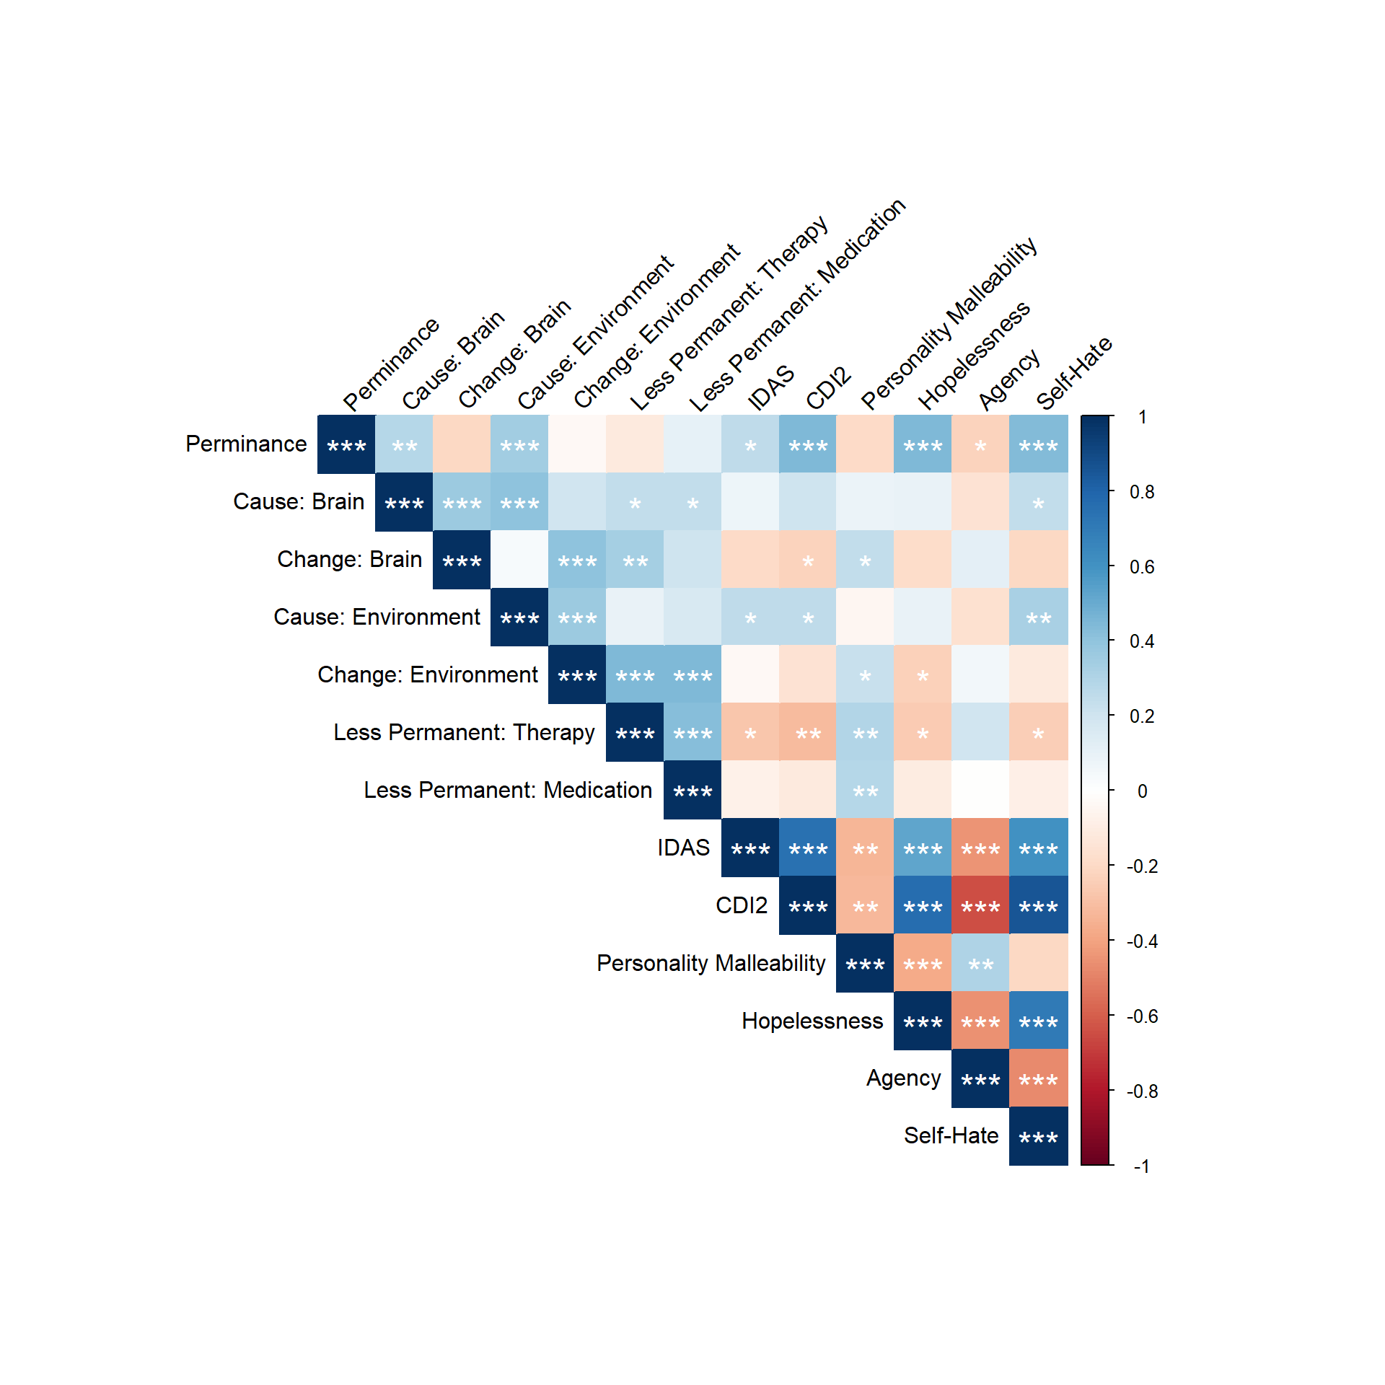
The strongest relationships between PPD measures and other constructs are with permanence and depression symptomatology, hopelessness, and self-hate

Slide 29
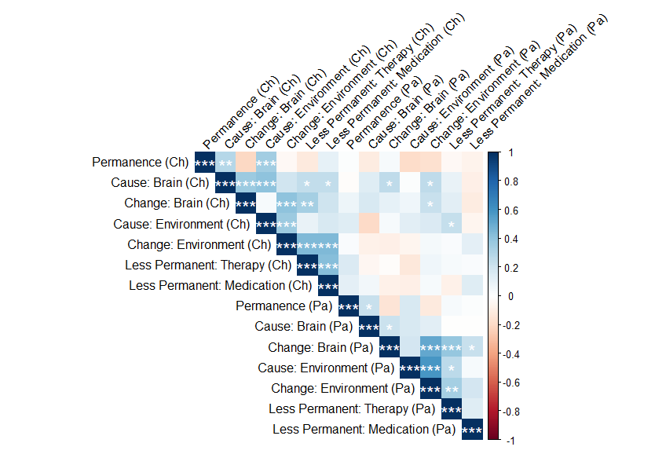
While we see similar patterns among parents, parent and child beliefs do not appear correlated

Slide 30
P.S. Remember This?

Slide 31
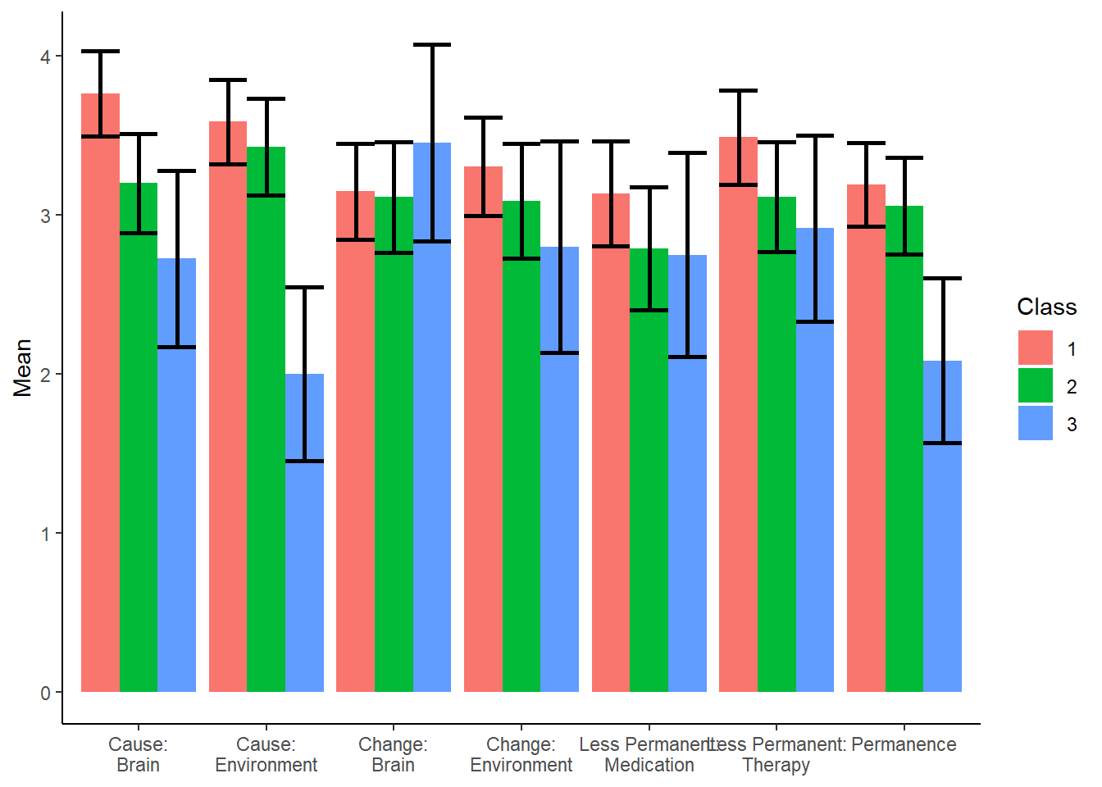
P.S. Remember This?

Slide 32
04
CONCLUSION

Slide 33
Conclusions
WHAT SYMPTOMS COUNT
BELIEFS ABOUT DEPRESSION
RELATIONSHIP BETWEEN BELIEFS
High-symptom adolescents tend to have a broader definition of depression
Girls and older adolescents tend to include more symptoms
High-symptom adolescents have a wide range of beliefs about depression’s causes and permanence
Beliefs vary by gender, age, and income
There is a moderate positive correlation between biological and environmental explanations for depression

Slide 34
Feedback
Unanswered questions?
Future directions?

Slide 35
THANK YOU

